Slide 1
Conditionals

Slide 2
Conditional Statements
If
If else
switch

Slide 3
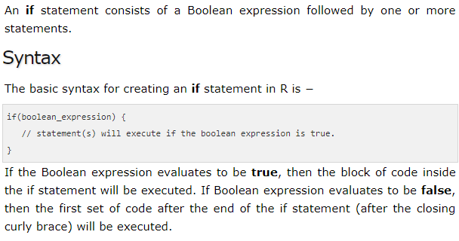
If statement

Slide 4

Example

Slide 5
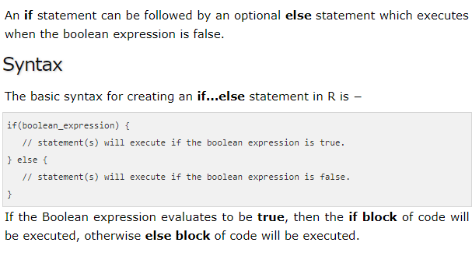
If else

Slide 6
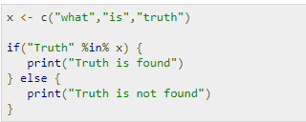
x <- 5
if (x > 0 && x < 10) {
print("x is positive and less than 10")
} else {
print("x is either negative or greater than 10")
}

Slide 7
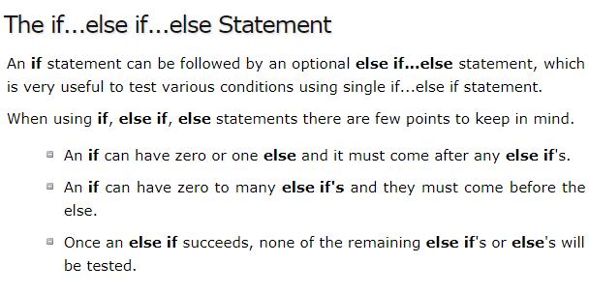

Slide 8
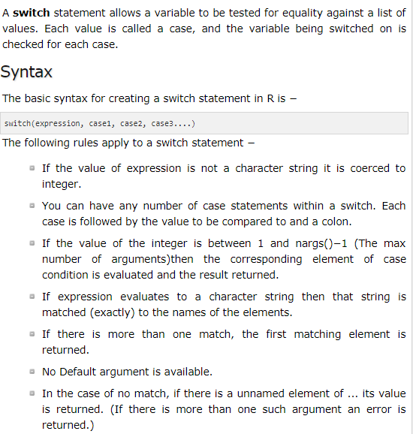

Slide 9
